Slide 1
Predicting whether a person is a voter or non-voter in america
Barrett Nibling
bnibling@gmail.com

Slide 2
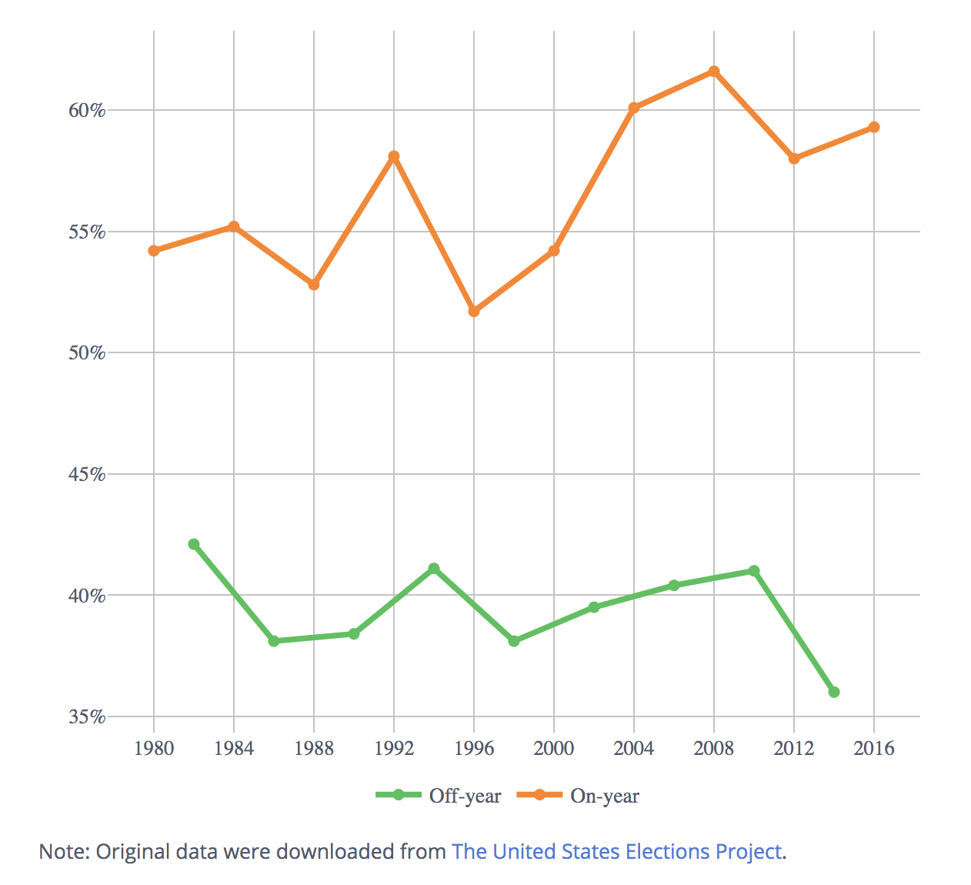
Voter turnout
Best measure of the health of the electoral process
35-60% eligible voters don’t vote
Can metrics determine if someone will vote or not?
Courtesy of The United States Elections Project: http://www.electproject.org/home/voter-turnout/voter-turnout-data

Slide 3

Why many Americans don’t vote.
Various demographics
Barriers to voting
Trust in the system
Beliefs about politics
https://projects.fivethirtyeight.com/non-voters-poll-2020-election/

Slide 4
FiveThirtyEight- Non-Voters Data
Polling done by Ipsos
Conducted from Sept. 15 to Sept 25
5,836 respondents matched voter file records by Aristole
119 Features:
Surveyed on 33 topics
Basic demographic data
Voter Categories
always: Voted in all or all-but-one eligible elections
sporadic: Voted in at least 2, but fewer than all-but-one eligible elections
rarely/never: Voted in 0 or only 1 eligible election
https://github.com/fivethirtyeight/data/tree/master/non-voters

Slide 5
Questions
What features make people decided to vote or not for any given election?
Can we predict who will vote and who will not vote from demographic and survey data?

Slide 6
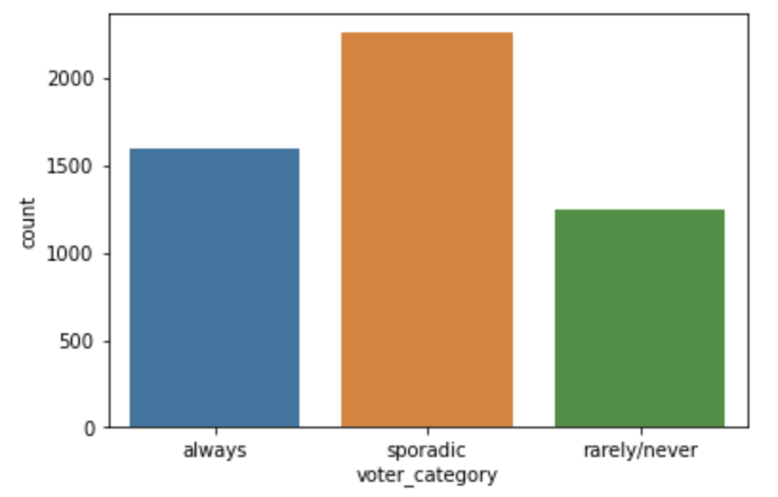
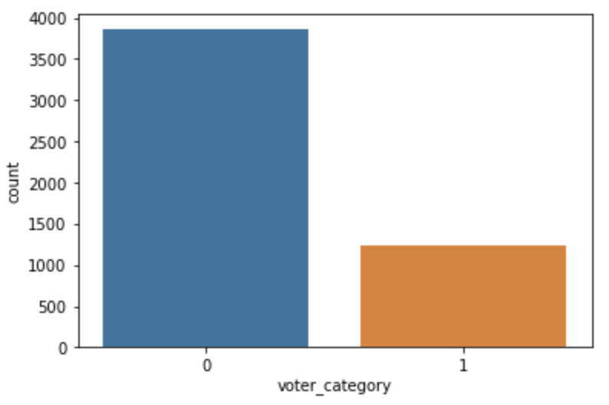
Methods
Data cleaning, remove null values, encoded features
Split into Train and Test sets (Test size = 0.2)
Supervised Learning Models
SVM Classifier
Random Forest Classifier
Gradient Boosting Classifier
XGB Classifier
Feature Selection
coefficients and feature_importances

Slide 7
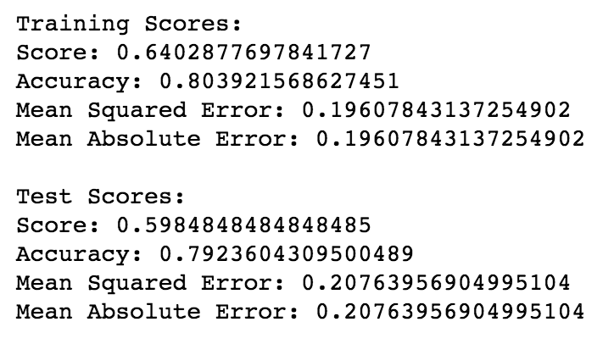
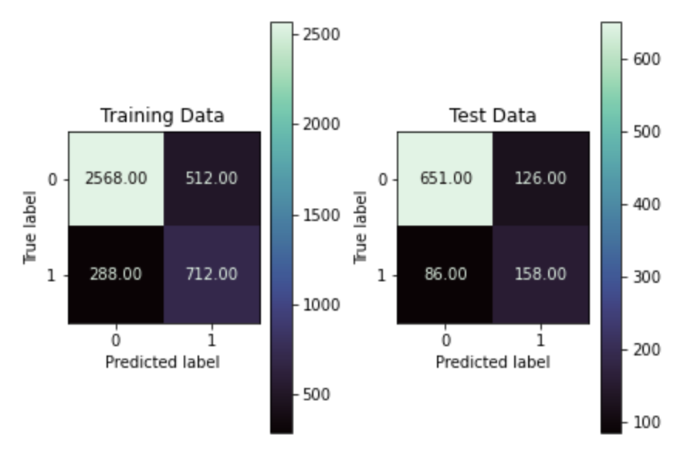
1. Linear SVC
Linear kernel was used to abstract the coefficients
Best parameters:
C = 1.0
class_weight = ‘balanced’
gamma = ‘scaled’
Results:
Fairly accurate with no overfitting
Highest error scores
Best recall

Slide 8
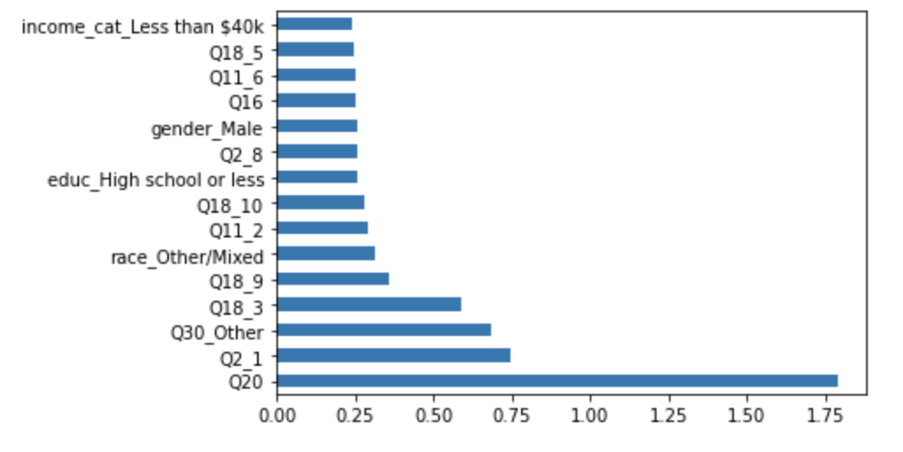
1. Linear SVC
Coefficient Data:
Q20 (Are you registered?) has by far the greatest impact
Others:
Q2_1- How important are elections?
Q30_Other- Non-party members
Q18_3- Registered before deadline?

Slide 9
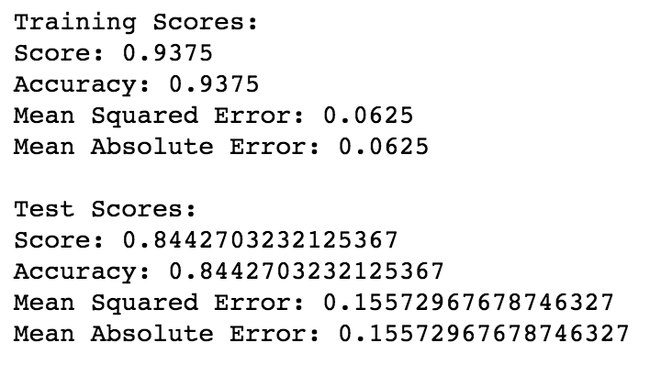
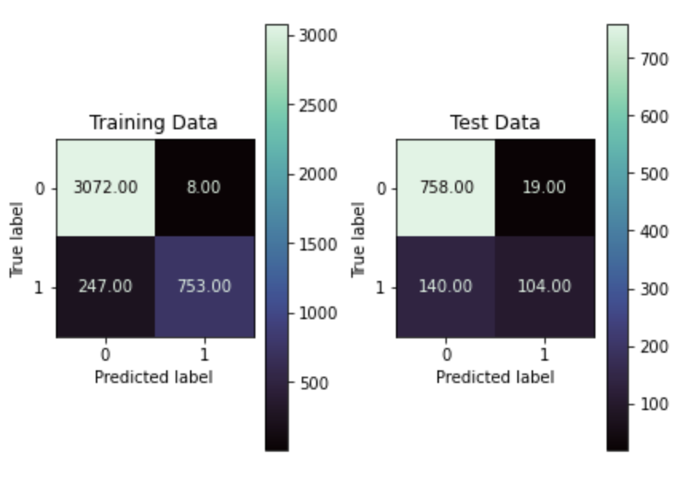
2. Random Forest classifier
Best parameters:
max_depth = 20
max_features = ‘sqrt’
min_samples_split = 10
criterion = ‘entropy’
Results:
Highest overfitting of training set
Slightly better test scores than SVC

Slide 10
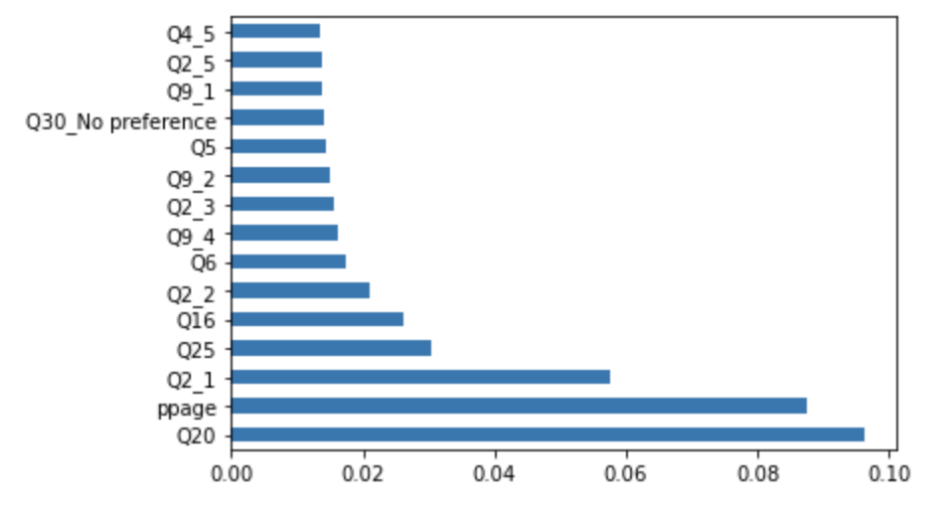
2. Random Forest classifier
Feature Importance Data:
Q20 is again the highest
Participants Age is also a main factor
Q2_1 also stands out
Others:
Q25- Do you follow the election?
Q16- Is voting easy?

Slide 11
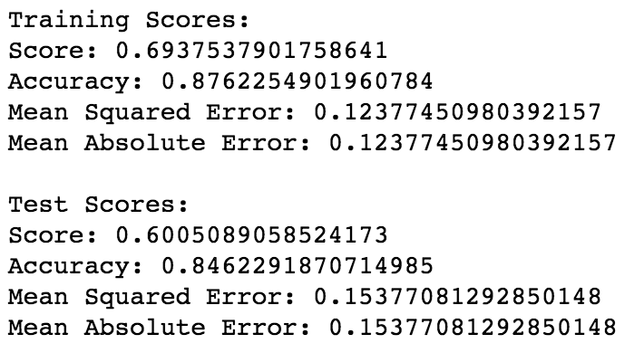
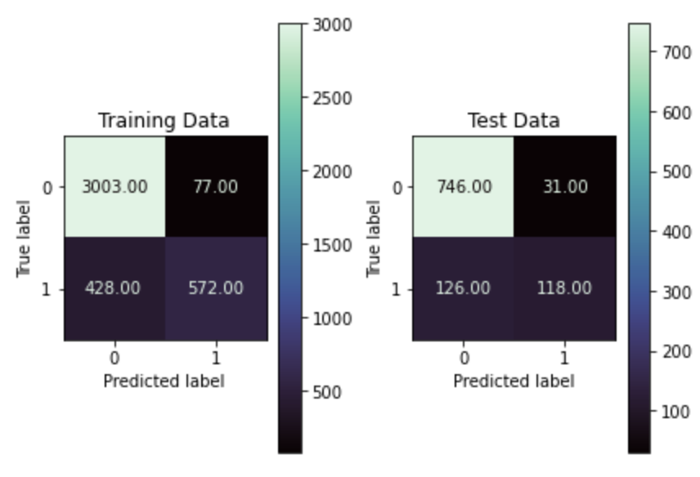
3. Gradient boosting Classifier
Best parameters:
Learning_rate = 0.025
max_depth = 3
subsample = 0.4
Results:
Lower score but highest accuracy
Lower errors than previous models

Slide 12
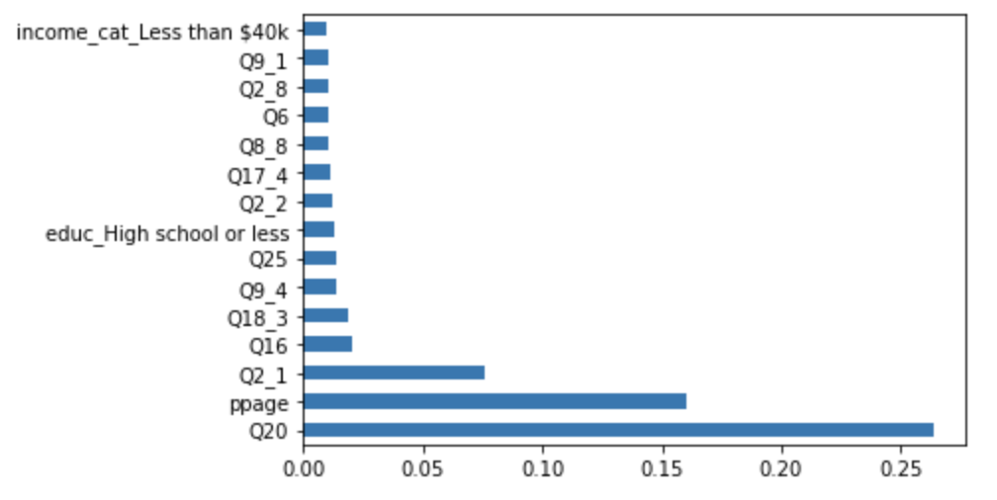
3. Gradient boosting Classifier
Feature Importance Data:
Q20, Age, & Q2_1 are again the highest and most notable

Slide 13
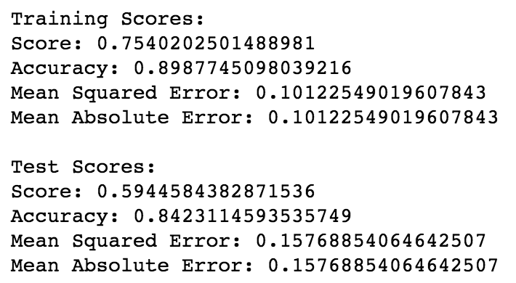
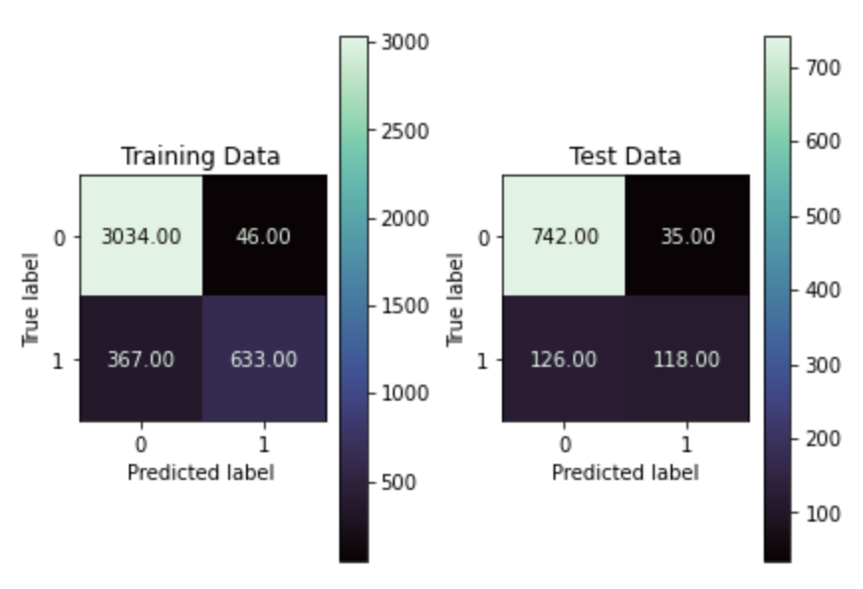
4. XGBoost Classifier
Best parameters:
Learning_rate = 0.025
max_depth = 3
subsample = 0.4
Results:
Best ratio of scores and errors, but not by much
Recall is still an issue

Slide 14
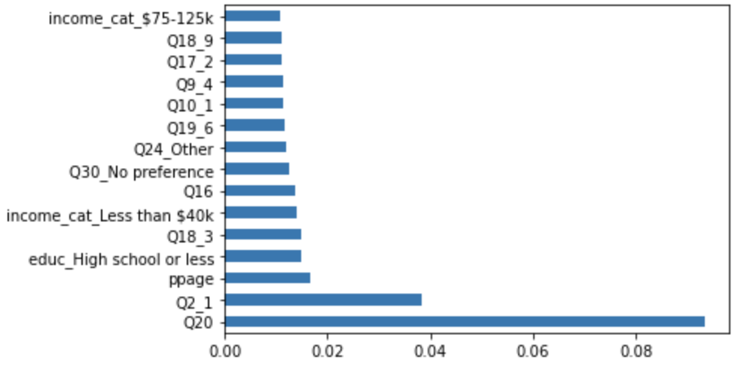
4. XGBoost Classifier
Feature Importance Data:
Q20 & Q2_1 are again the highest and most notable

Slide 15
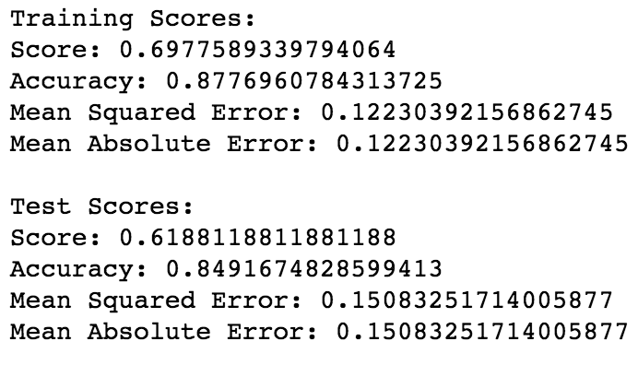
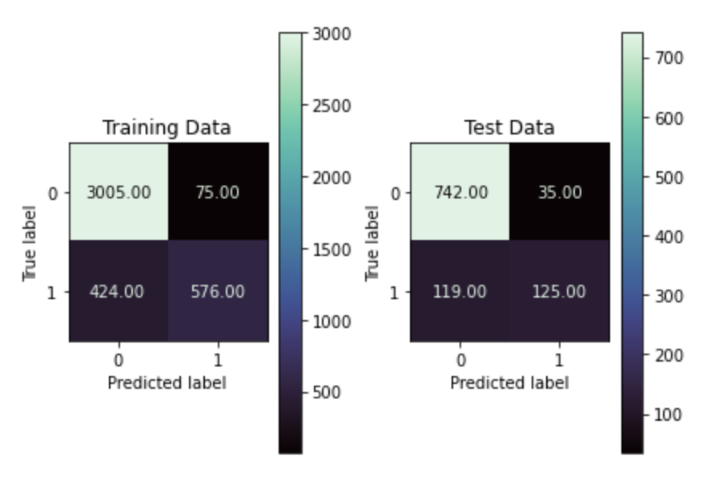
Final with reduced features
Selected best 23 features
Top 10 from previous models
XGBoost Model
Best parameters:
Learning_rate = 0.025
max_depth = 3
subsample = 0.4
Results:
Similar scores as before

Slide 16
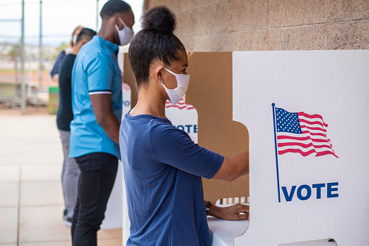
Conclusion
Supervised Learning models can predict Voters and Non-voters with a fairly larger degree of accuracy (0.85 Test accuracy)
Recall scores were low for all models. Resampling and weights improves this but at the cost of precision.

Slide 17

Recommendations
Barriers to voting are the biggest contributors
Voting Registration was the predominate feature in all models.
Ease of voting was also a factor
Ensuring people easier methods to register to vote and making the actual process as straight forward as possible will likely increase voter turnout.

Slide 18

Future Considerations
Fix the issue of imbalanced data in the target feature
Potentially drop sporadic voters
Conduct another poll with other questions
Improve the ordinal ranking of the questions
Increase the number of participants
Test for `always` voters instead of `never` voters

Slide 19
Thank you for listening
Barrett Nibling
bnibling@gmail.com

Slide 20
Additional slides

